Slide 1
Team TAP Teach, Access, Partner
November 7, 2021

Slide 2

The Story
Team TAP
This Photo by Unknown author is licensed under CC BY-NC-ND.
TAP Teach, Access, Partner
Notes:
A few months ago – Receive a call from a close friend who is newly diagnosed with type 2 diabetes.
Single mom of 2.
Works 2 jobs to make ends meet.
Despite the education material provided to her by her nurse, she remained fearful and confused about her new diagnosis and how to manage it. She had difficulty remembering everything the nurse told her after she got home.

Slide 3
Globally 462 Million patients with Type 2 Diabetes
Team TAP
Patient Dx
Patient Confusion
Poor Compliance
Readmission
Additional load on nurses –nurse burn out
Notes:
This is not an isolated problem – globally there are 462 million people with type 2 diabetes.
Studies show that retention of education is poor in medical settings due to distractions, single modality of teaching, lack of repetition, and lack of partnership with patient's support system.
When these patients do not have good retention of education about their condition, there is increased risk of negative outcomes and hospital readmission.

Slide 4
Globally 462 Million patients with Type 2 Diabetes
Team TAP
TAP
Patient Dx
Patient Confusion
Poor Compliance
Readmission
Additional load on nurses –nurse burn out
Notes:
We have a solution to break this cycle – to better educate patients and lead to better outcomes for the patients and less burnout for the nurses doing the education.
TAP – Teach, Access, and Partner with the patient

Slide 5
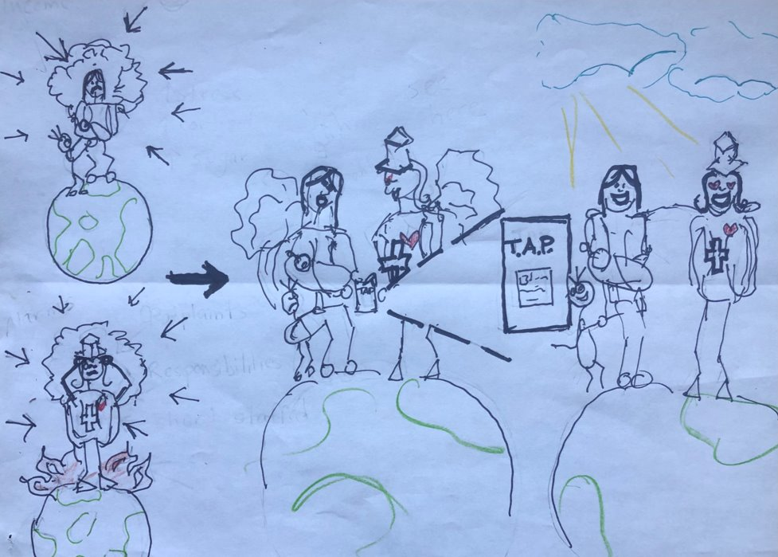
Team TAP
Notes:
As seen on the left, both the patient and nurse are overwhelmed.
In the middle, the patient will partner with a nurse using the TAP website, to learn more about their new diagnosis of diabetes.
In the end, this will leave the patient more supported and able to smile.

Slide 6
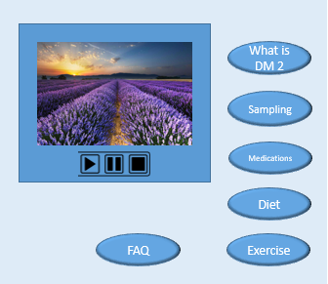
Diagnosis
Clinician-Guided Learning
Independent Learning
Team TAP
TAP - Teach Access Partner
Register
Create a Profile
Goal
My Progress
Education Tools
Notes:
TAP is a website that will be part of the patient's learning journey starting with a diagnosis of diabetes
A clinician will guide the patient to our website
where they will create a profile be guided to a roadmap of multimodal educational modules – videos and text
The patient can continue to access these modules at home with family and review them "just in time" when they need a refresher on skills
They will also have access to nurse consultants who are able to partner with patients as their coaches
Can be used by hospitals, primary care offices.

Slide 7
Our Model
Nurses practice at the top of their license
Expert nurses reduce load of unit nurses
Reduce burnout
Increase retention
Reduces readmission
Cost savings to healthcare systems
Nursing expertise
Sharing the load
Mutual Benefits
Improved patient health
Team TAP
Notes:
TAP helps nurses practice at the top of their license. Expert nurse consultants will be a subcontracted service as patient coaches
Expert nurses can reduce the load of other nurses
Reduce burnout by providing resources to accomplish education
And Reduce hospital costs for patients with diabetes by keeping them out of the hospital

Slide 8







Funding
Team TAP
Grant providers supporting diabetic education services:
Diabetic Education is a billable service
Notes:
For funding:
1) Nurse education time is reimbursable by Medicare
2) We will also seek grants to help get us off the ground

Slide 9
Our Solution vs. The Competition
Team TAP
Benefits | TAP | Livongo | One Drop
Level of User Understanding | Support newly diagnosed | Ongoing management | Ongoing management
Cost to Use | Free to patient Billable to insurance | Free Billed to insurance | $19.99/month to access all features
Platform | Web-based | iPhone & Android app | iPhone & Android app
Users | Patients, Families, Caregivers, Clinicians | Patients only | Patients only
Notes:
Our solution is specific to those newly diagnosed. It is free to the patient, but billable to insurance.

Slide 10
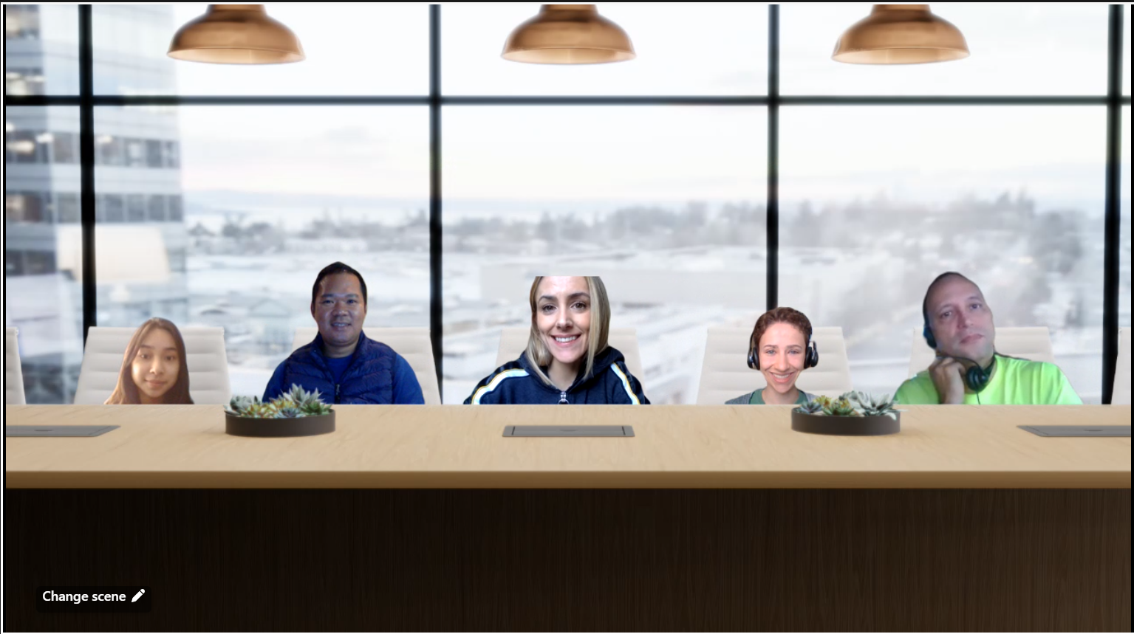
TAP: Teach. Access.Partner. Helping Nurses Help Patients One TAP at a time
Team TAP
Camille Choi Blair Claire Bob
Team Members
Choi Bagnol, MSN, RN, PCCN – RainouldBagnol@yahoo.com
Camille Chiong, High School Student
Claire Eide, MN, RN, PHN, PCCN, and type 1 diabetic – claireleide@gmail.com
Blair Paton, RN, BSN, Graduate Student in Nursing Informatics
Bob Wachtl, DNP, MSN, MHA, BSN, CCM
Notes:
TAP: Helping Nurses, Help patients one tap at a time
With our experienced, passionate team of nurses.

Slide 11
Questions?

